Slide 1


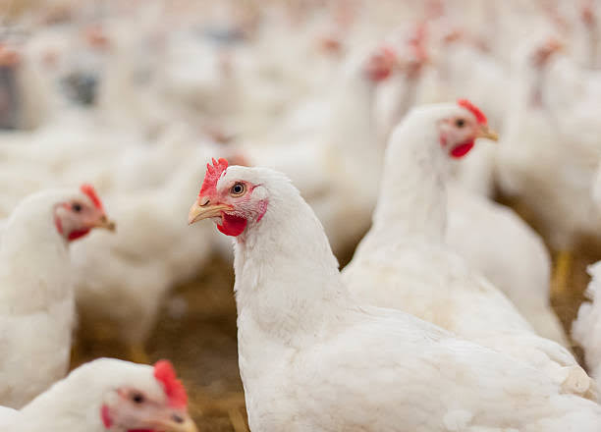
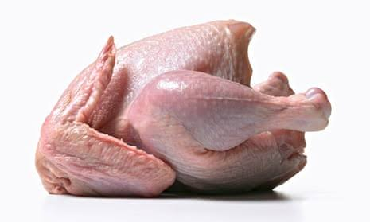
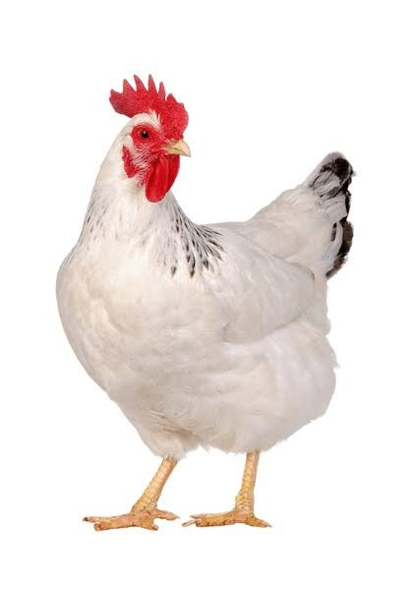
PITCH DECK
Business name: Chicken FITII
Vision: CONNECTING FRESHNESS TO YOUR DOORSTEP
by: MICHAEL GONA KATANA

Slide 2

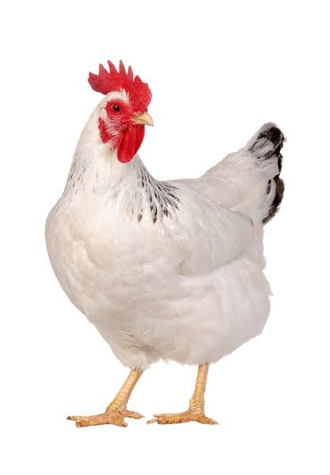
PROBLEM STATEMENT
In our fast-paced world, consumers are increasingly demanding fresh, high-quality food delivered conveniently to their doorsteps.
However, the chicken supply chain is riddled with issues:
- Limited access to local suppliers.
- Inconvenient purchasing and delivery options.
- Lack of transparency and trust in sourcing.
- Inconsistent quality and freshness.
Consumers and restaurants struggle to find reliable sources of fresh chicken, leading to dissatisfaction and missed opportunities for suppliers.

Slide 3


PROBLEMS
WE WILL SOLVE THE PROBLEMS
02
Inconvenient Purchasing and Delivery
01
Limited Access to Local Suppliers
Traditional purchasing methods for chicken are often time-consuming and inconvenient. Consumers must visit physical stores or markets, which can be inconvenient, especially for those with busy schedules.
Limited Hours as Retail outlets have specific operating hours, limiting flexibility for consumers to purchase at their convenience.
Consumers and businesses struggle to find and connect with local chicken suppliers as many of these suppliers do not have the resources or platforms to market themselves effectively, limiting consumer awareness of their products.
03
Lack of Transparency and Trust in Sourcing
Traditional supply chains are complex and opaque, making it hard for consumers to trace the origin and handling of the chicken they purchase.
Inadequate or misleading labeling can leave consumers unsure about the quality, farming practices, and safety of their food.
06

Slide 4
SOLUTIONS
01
Limited Access to Local Suppliers
SOLUTIONS OF THE PROBLEMS
Chicken FITII bridges the gap by connecting consumers directly with local chicken suppliers through a seamless, user-friendly app. Multiple suppliers can log in, list their products, and manage orders.
02
Inconvenient Purchasing and Delivery
Efficient delivery options tailored to customer needs.
02
Lack of Transparency and Trust in Sourcing
Detailed information about the origin and handling of each product.

Slide 5
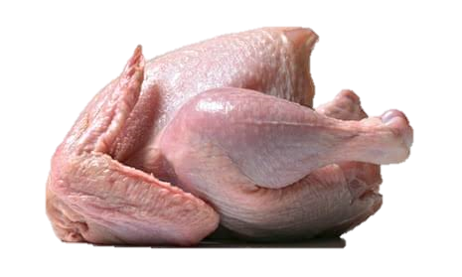

Chicken FITII
YOUR ONE STOP SHOP FOR KUKU
Product
Your Fresh Chicken, Just a Click Away
Our website and app offers:
User-Friendly Interface: Intuitive app design for easy navigation.
Supplier Login: Suppliers can easily register, list products, and manage inventory.
Order Tracking: Real-time updates on order status and delivery.
Customer Reviews: Building trust through transparent reviews and ratings.
Customer
Makes an order
App/website notifies supplier
After delivery payment is made to supplier either through app or direct to supplier
Suppliers agrees with consumer and the delivery means and charges
Supplier confirms and approves order
04

Slide 6


Target Market
The poultry market is expanding rapidly with an estimate of global Market Size of $320 billion by 2025.
My target audience is:
Households and restaurants seeking reliable and quality chicken sources. Chicken FITII is poised to capture a significant share of this growing market by addressing unmet needs.
I want to capture the market in Nairobi county for the first year before expanding to other counties

Slide 7
Market Size
Nairobi County presents a substantial market opportunity for Chicken FITII, given its large and diverse population.
Total Population: Approximately 4.4 million people
Households: Around 1.3 million households
Restaurants: around 3000
Tapping on to a quarter of that households and a half of the restaurants
My market size is around: 325.1K
This is my Total Available market ( TAM ) = 325.1K
My SAM ( Serviceable available market ) = taking 60% of TAM = 195.06K
Looking at the market, I can reach to 20% of the restaurants and household.
My SOM ( serviceable obtainable market ) = 20% of SAM = 39.012K

Slide 8
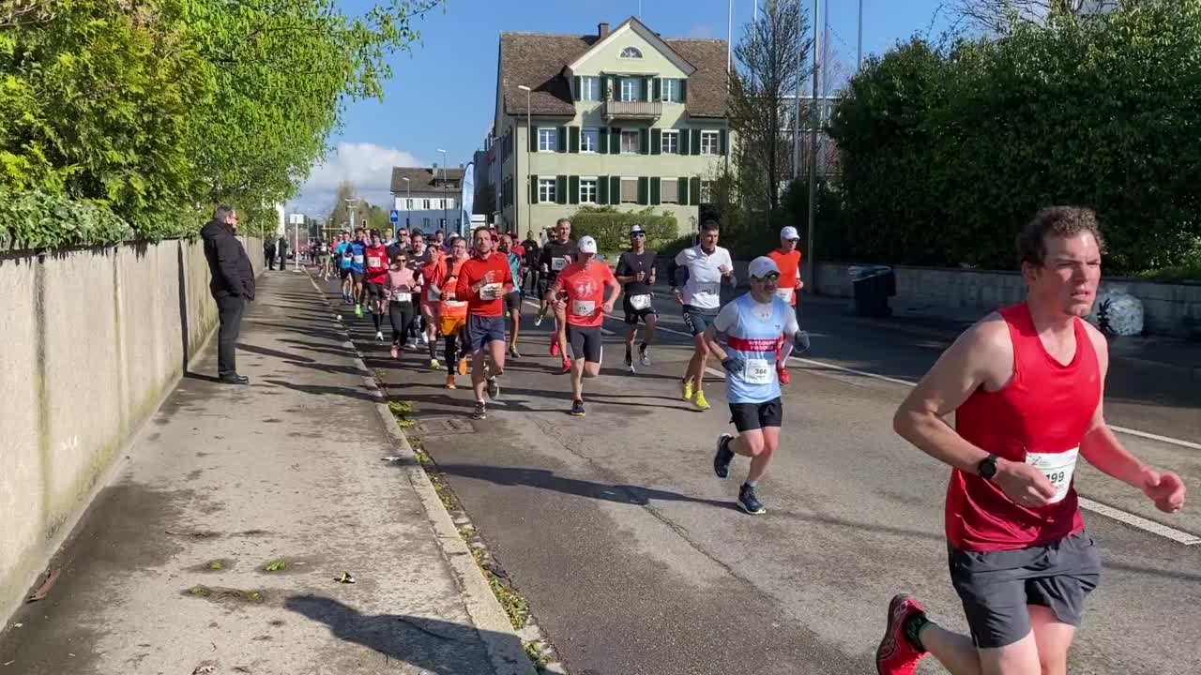
Competitors
Standing Out in a Crowded Market
Competitors:
Direct farm-to-table services.
Traditional grocery delivery apps.
Specialty food delivery services.

Slide 9

Competitive Advantage
What makes us unique?
Our Edge:
Exclusive focus on chicken.
Comprehensive supplier marketplace.
Rigorous quality assurance.
Superior user experience.
.

Slide 10
Project Traction
Tasks
Month 1
Month 2
Month 3
Month 4
Month 5
Doing more research on the app and site
Developing the app and website
Finalizing on website and app development
Testing on the functionality of the website and app
Getting my first 100 suppliers to sign up
Presenting the app and website to customers
Using, upgrading and maintaining the website and app

Slide 11

Business Model
Chicken FITII Revenue Streams:
Commission:
Earn 10% on each sale made through the platform from suppliers.
Delivery Fees:
Charge customers a nominal fee for delivery services.
Subscription Model:
Offer premium memberships with benefits like free delivery and priority service for a monthly or annual fee.

Slide 12
Go To Market
Go-to-Market Strategy
Capturing Hearts and Taste Buds through:
Digital Marketing: Leveraging social media, SEO, and online ads to reach our target audience.
Local Partnerships: Collaborating with local farms, markets, and restaurants to build a robust supplier network.
Customer Retention: Loyalty programs, referral bonuses, and excellent customer service to ensure repeat business

Slide 13
Social Impact
Good Health and Well-being
Promote healthier diets by providing access to fresh, high-quality chicken.
Decent Work and Economic Growth
Create job opportunities within the supply chain, from local farmers to delivery personnel.
Zero Hunger
Support local farmers and suppliers, enhancing their income and food security.
Industry, Innovation, and Infrastructure
Utilize technology to streamline the chicken supply chain and improve efficiency.
Develop robust infrastructure for sourcing, quality control, and delivery of chicken.

Slide 14
Our Ask
Funding Requirements: $1200
Outline of Fund Usage
Technology and Development - $500
App Development and Maintenance: $400
Building and enhancing the user interface and user experience.
Ensuring smooth functionality for suppliers and customers.
Server Hosting and Cloud Services: $100
Hosting the platform on reliable servers for seamless access.
Marketing and Customer Acquisition - $400
Digital Marketing Campaigns: $250
Social media ads, Google Ads, and SEO efforts to attract users.
Promotional Materials: $100
Flyers, posters, and other materials to raise awareness.
Launch Event: $50
Hosting an event to introduce Chicken FITII to the community.
Operations and Logistics - $200
Initial Delivery Fleet: $100
Renting or acquiring vehicles for efficient delivery.
Packaging Materials: $100
Ensuring high-quality, safe packaging for chicken products.
Miscellaneous Expenses - $100
Contingency Fund: $50
Covering unexpected costs or emergencies.
Legal and Administrative Fees: $50
Incorporation, permits, and other necessary legal documentation.

Slide 15
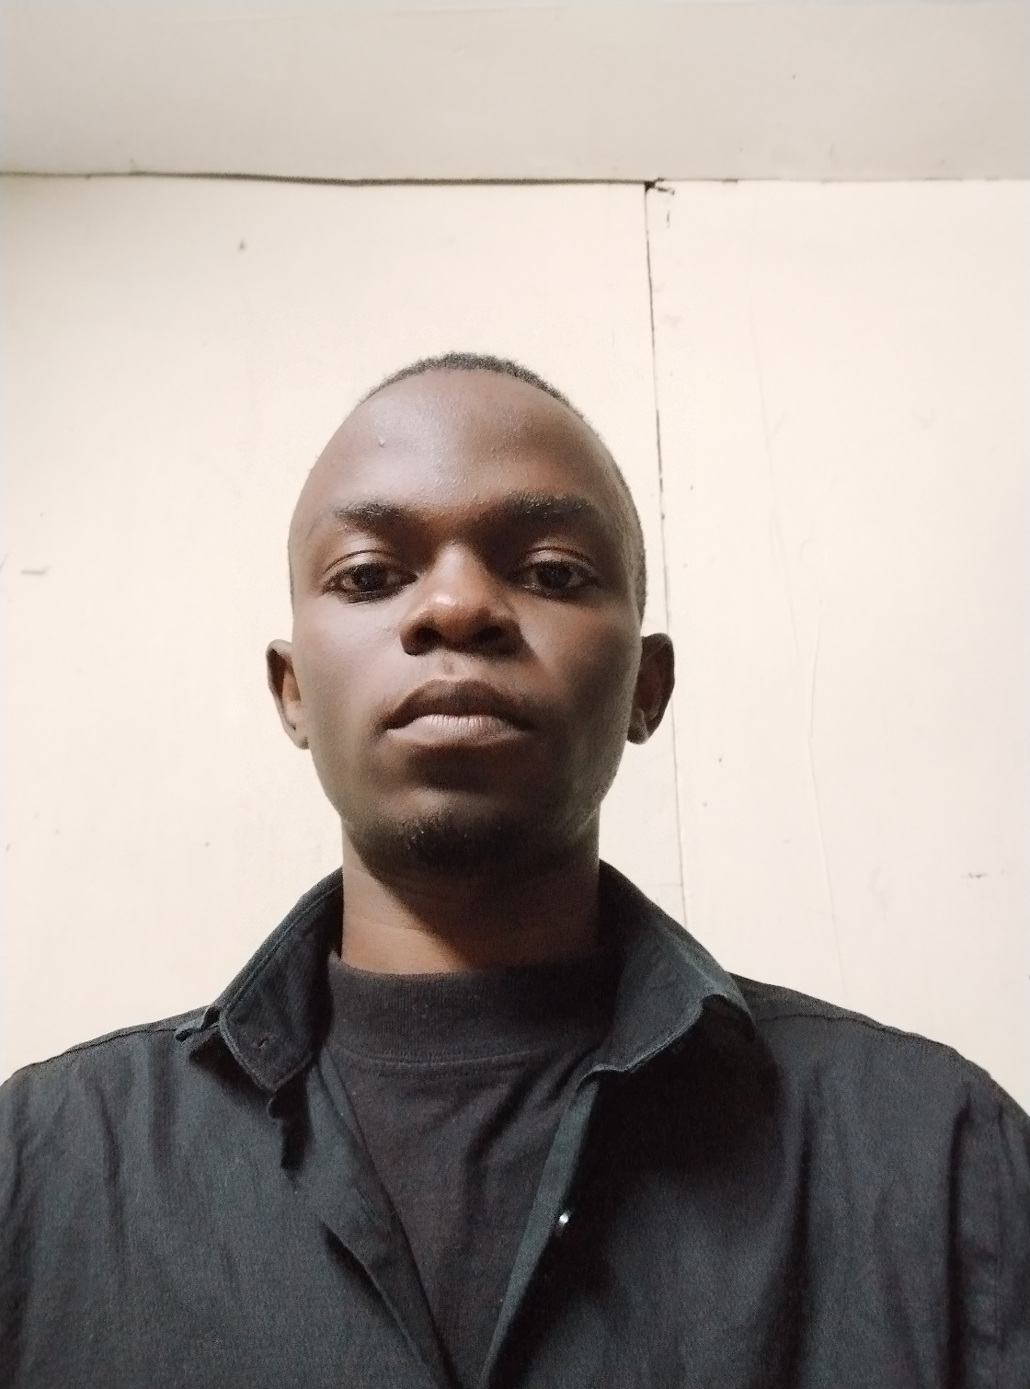
Team
Mr. MICHAEL GONA KATANA
FOUNDER, CEO:

Slide 16




Thank you!
PHONE: 0741072279
EMAIL:mickeygkatana@gmail.com

